Slide 1

Is a college education a good value?

Slide 2

Strategy
Collect information on:
Student loans
Salary based on education and location
Compare and contrast the expected salary based on state of residence
Is a college education a good investment?
Are there some majors that are a better investment than others?
Are there some locations where an education is a better investments?
Introduce tool to determine WHEN a college education starts to pay off.

Slide 3
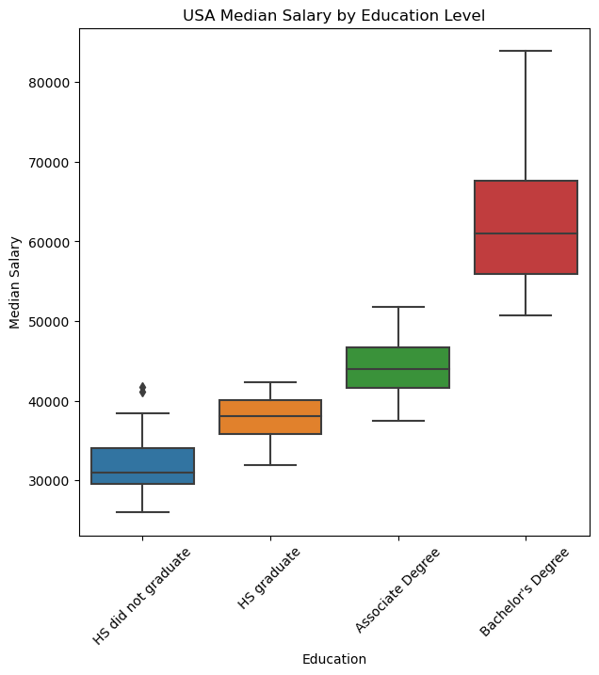
Median salary increases based on education.
Does this trend hold true everywhere in the United States?

Slide 4
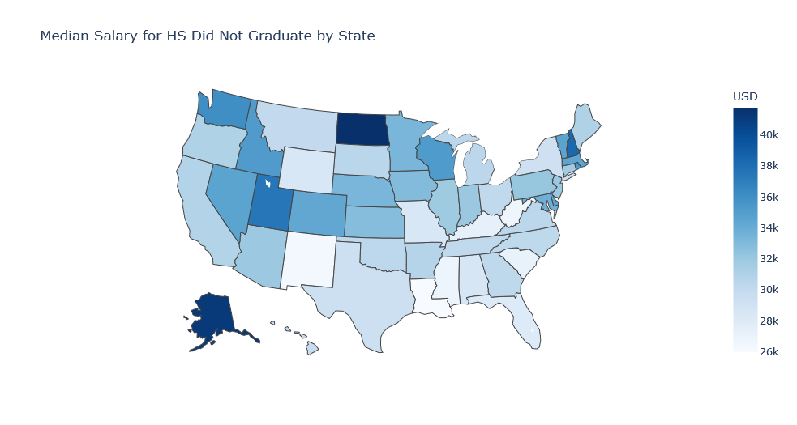
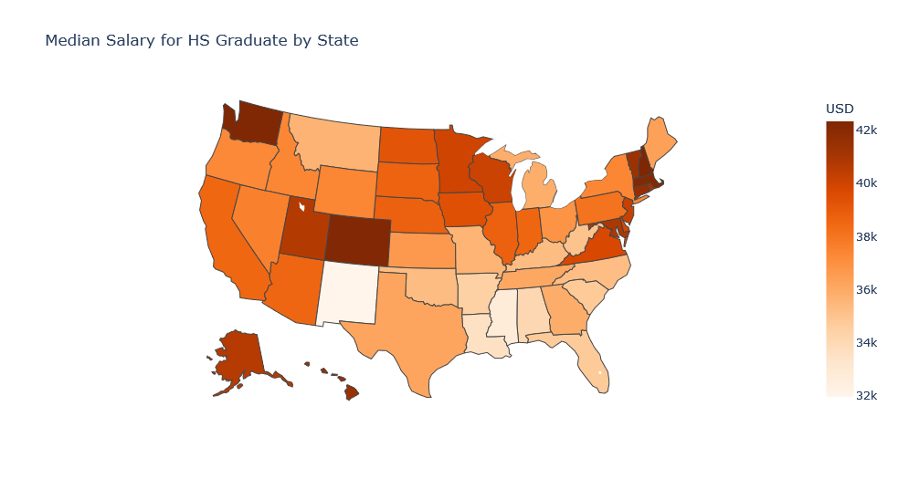
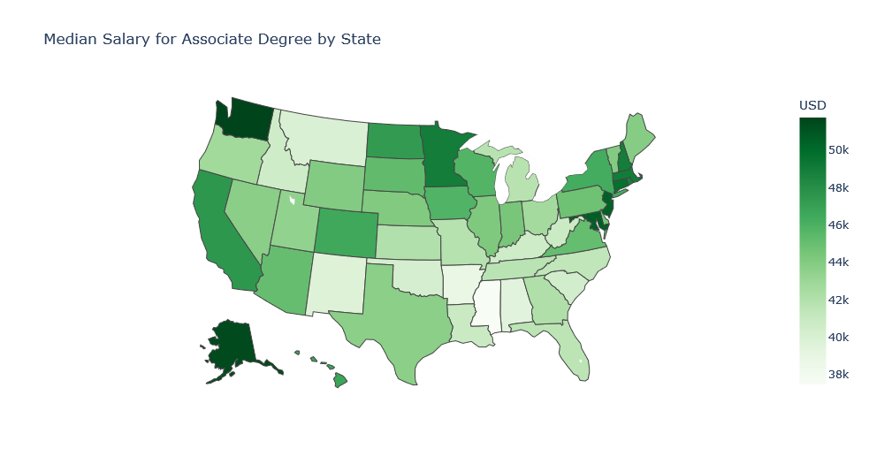
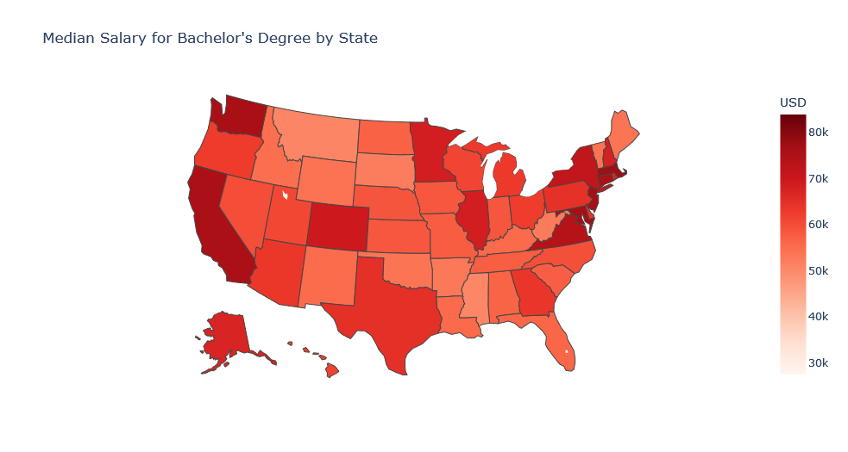

Slide 6
Does your choice of major matter?

Slide 7
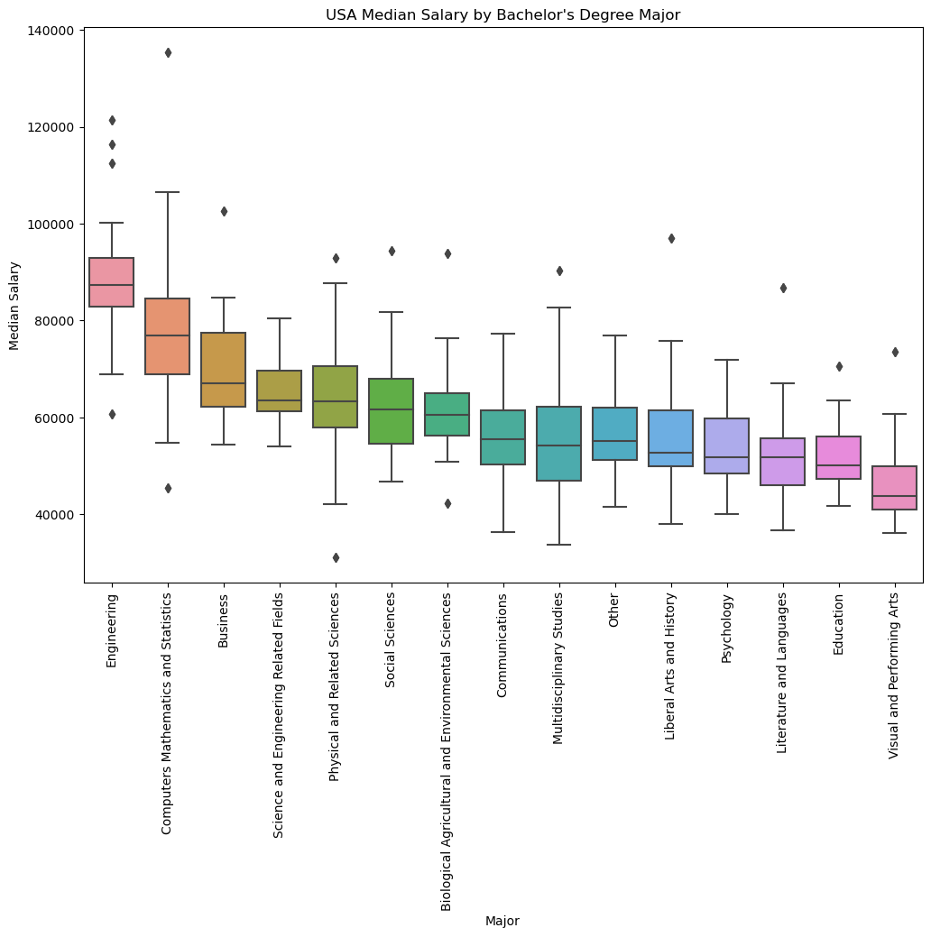
There are a few outliers in terms of education and salary.

Slide 8




How do we measure if education is a good investment?
Imagine that you had to decide between 4 options in regards to your education and starting work. You can:
Leave high school at age 16.
Graduate high school at age 18.
Graduate with an associates at age 20.
Graduate with a bachelor’s at age 22.
Which decision makes the most sense financially?

Slide 9
[INSERT POWER BI]

Slide 10
Conclusions
Education is a good investment in general. Most people with a Bachelor’s will end up making more overall.
Money isn’t the most important thing! Education opens up many doors for a person’s career and doing a job you enjoy is a valid consideration when picking a career.
Location and Major are very important!

